Slide 1
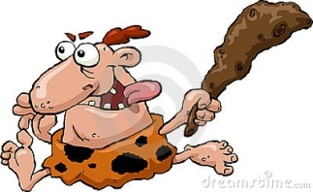
GLOSSARY UNIT 1 PREHISTORY
Word | Spanish | Definition
Nomad | Nómada | People that move around in search of food
Sedentary | Sedentario | People that live permanently in one place
Tool | Herramienta | Object used to make something
Harpoon | Arpón | Long pointed instrument used for fishing
Needle | Aguja | Long, pointed tool used for sewing
To gather | recolectar | Collect food from nature
Predator | Depredador | Animal that eats things from nature and does not produce them
Livestock | Ganado | Domesticated animals raised by humans
Biface | Bifaz | Stone tool with 2 faces, almond shaped and sharp
Hand mill | Molino de mano | Tool used to pulverize grain and make it flour
Pottery | Cerámica | Ceramic
Loom | Telar | A tool used for weaving
To weave | tejer | To make fabrics by interlacing threads
Smelting | Fundición | Action of melting metals
Wheel | Rueda | Round tool useful for transport
Sail | Vela | Rectangular piece of fabric used in boats to take profit of the wind force
Social group | Clase social | Group in which the society is divided, richer or poorer.
Warrior | Guerrero | Person who works in defending people
King | rey | The most powerful warrior of a place

